Slide 1
Optical Comb and Laser Locking
Mingda Li
July 2, 2023

Slide 2
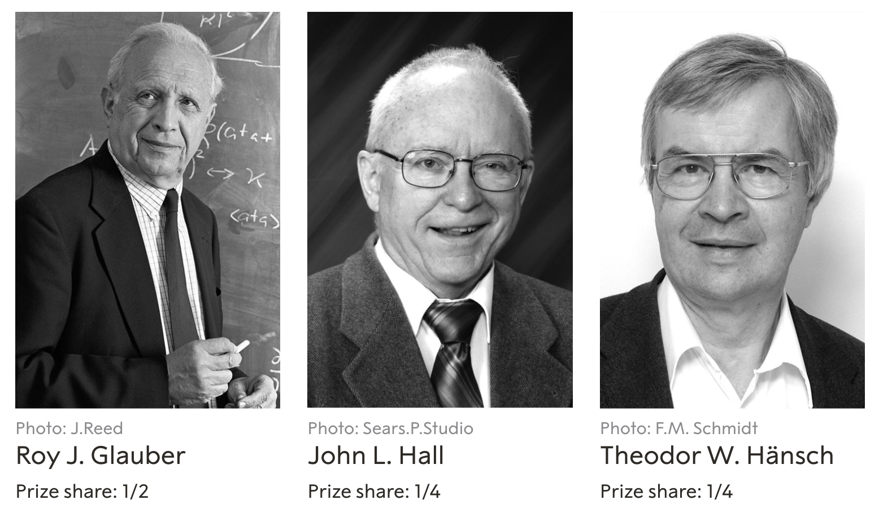
John L. Hall and Theodor W. Hänsch "for their contributions to the development of laser-based precision spectroscopy, including the optical frequency comb technique"

Slide 3
Outline
Frequency comb
Understand the comb
Self-referencing method
What is laser locking?
Wavemeter
PDH locking
Comb

Slide 4
Part 1. Frequency comb

Slide 5
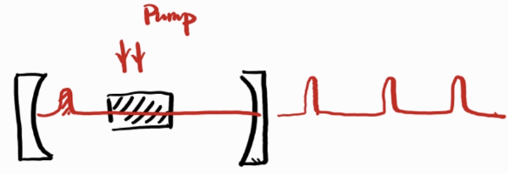
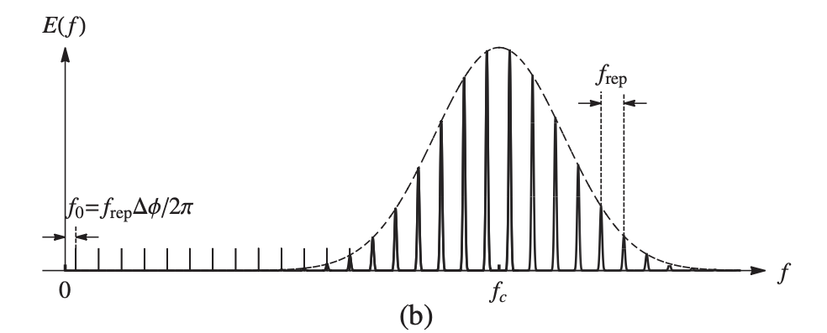
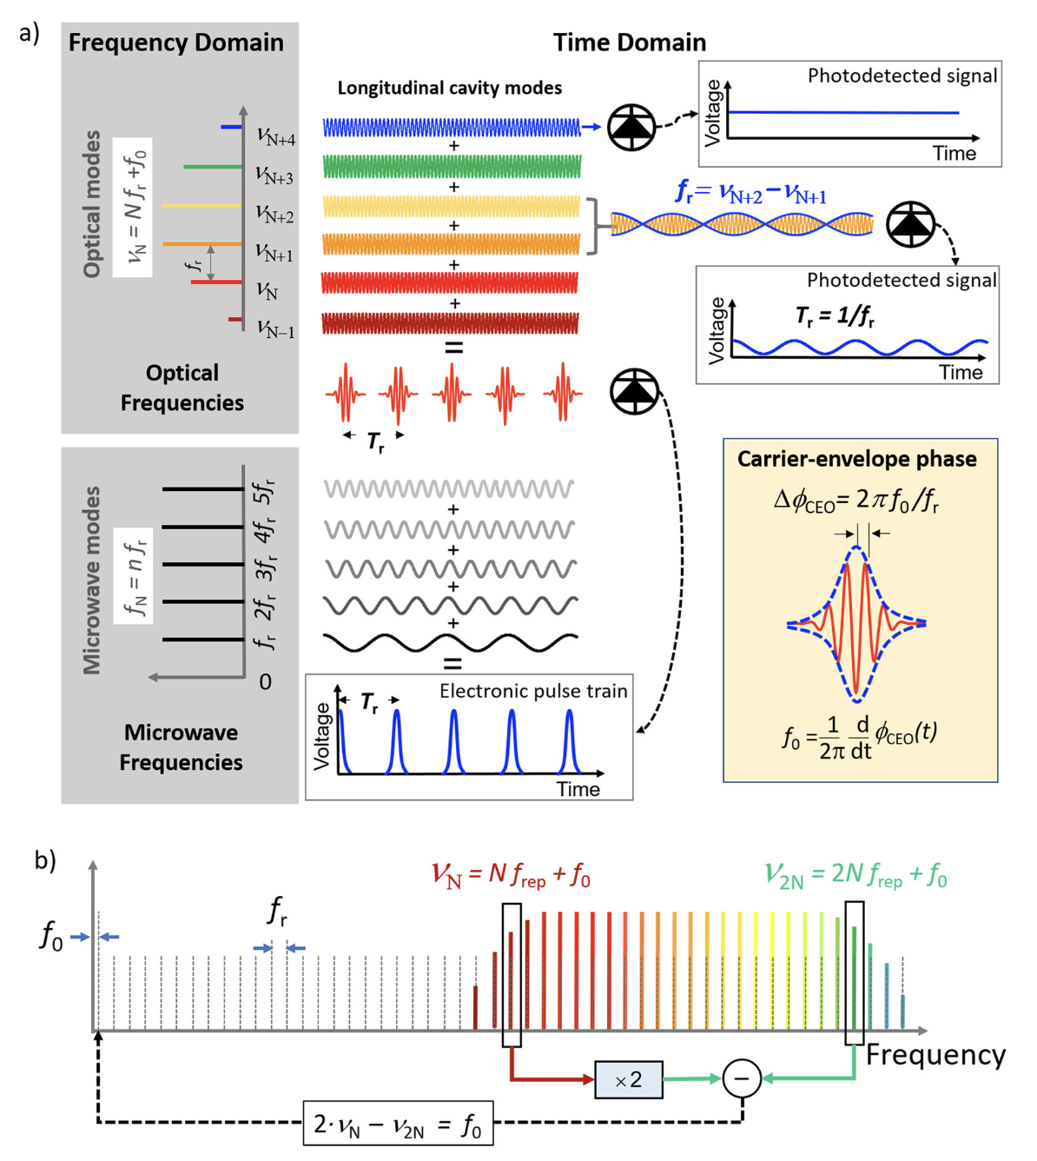
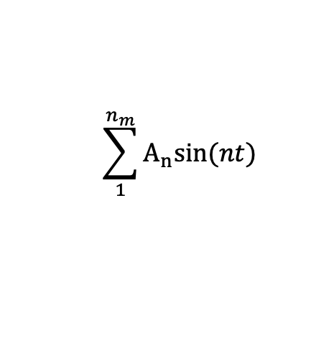
What is frequency comb?
Mode-lock
ultrafast laser
Fourier transformation
Frequency comb
$$\sum_{1}^{n_{m}}{A_{n}sin⁡(nt)}$$
Arvanitaki, Searching for dilaton dark matter, 2015

Slide 6
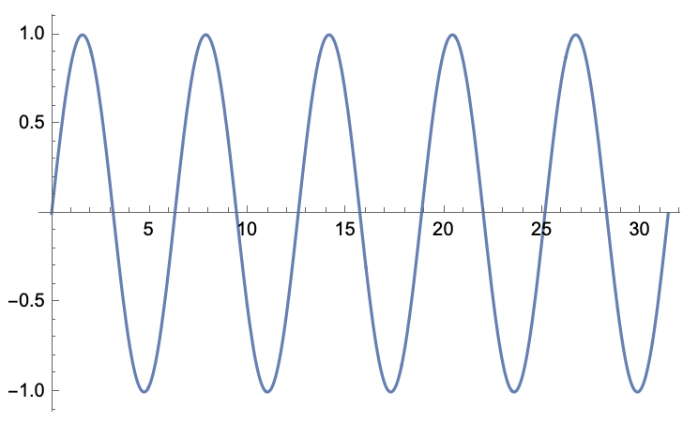
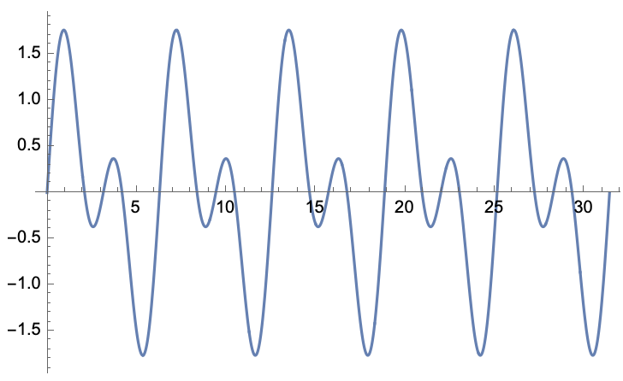
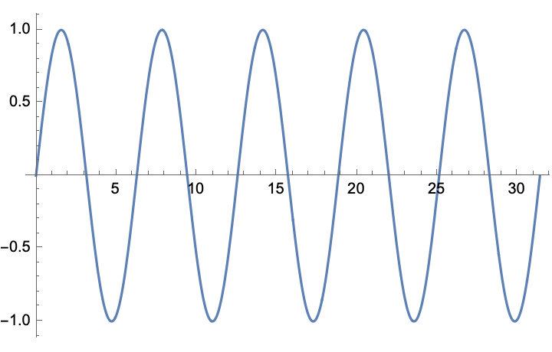


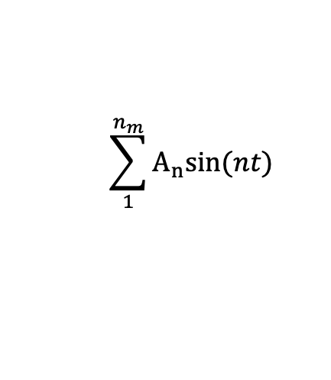

Understanding optical comb
$$\sum_{1}^{n_{m}}{A_{n}sin⁡(nt)}$$
What does the look like?
$$sin⁡(t)$$
$$\sin\left(t\right)+sin⁡(2t)$$
$$\sin\left(t\right)+\sin\left(2t\right)+…$$
Thanks to Yanfei

Slide 7
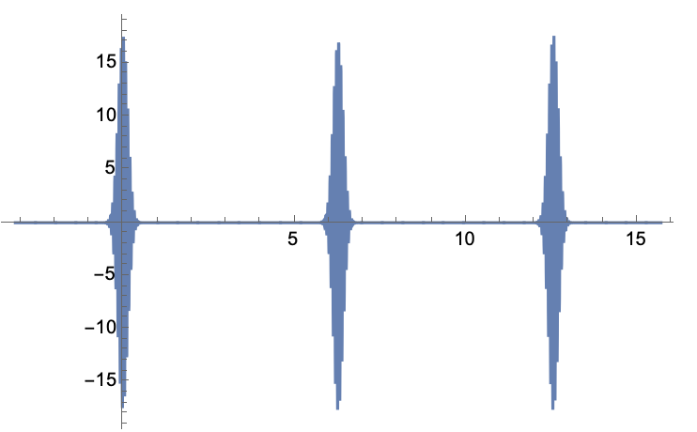
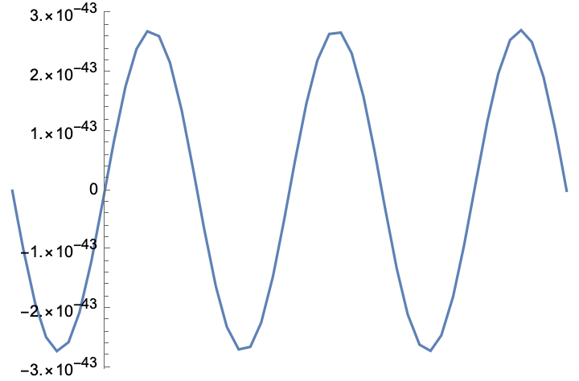
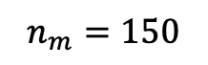
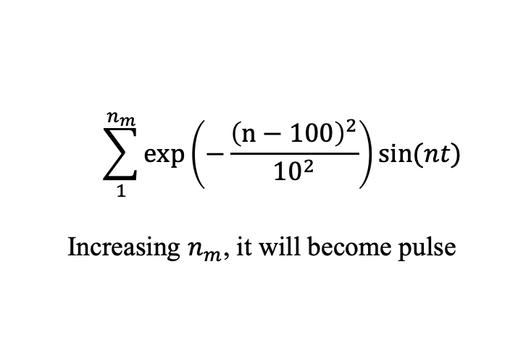
Understanding optical comb
$$\sum_{1}^{n_{m}}{A_{n}sin⁡(nt)}$$
What does the look like?
If we modulate the amplitude with a profile, then it will be…
$$n_{m}=150$$
$$\sum_{1}^{n_{m}}{exp\left(−\frac{{\left(n−100\right)}^{2}}{{10}^{2}}\right)sin⁡(nt)}$$
Increasing $n_{m}$, it will become pulse
Ultrafast pulse sequence

Slide 8
Summary of the understanding
Freq domain
Time domain
T. Fortier, E. Baumann, Communications Physics(2019)

Slide 9
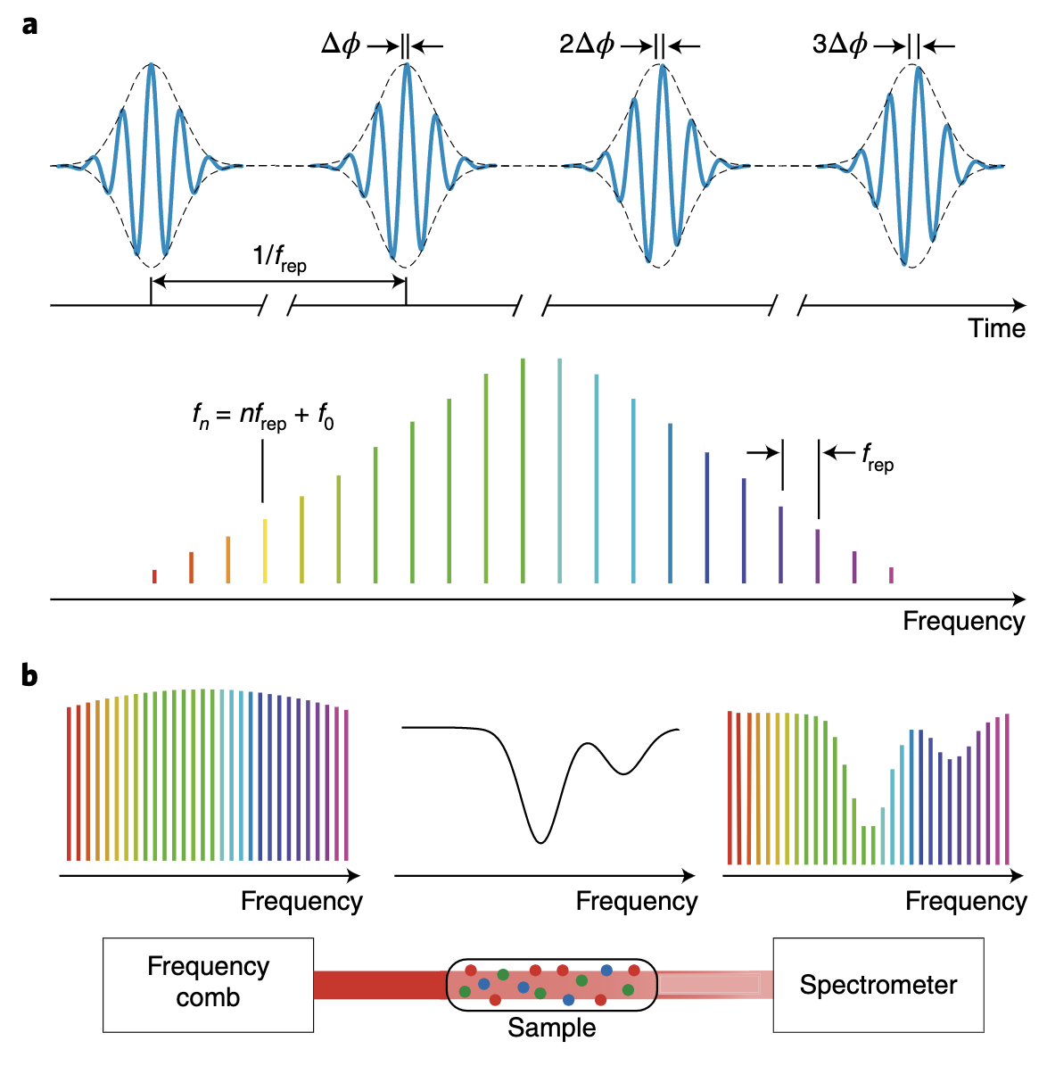
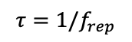

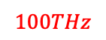
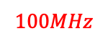
What is frequency comb?
Mode-lock Ultrafast laser
Fourier transformation
Frequency comb
$$τ=1/f_{rep}$$
$$f_{0}=f_{rep}×\frac{∆φ}{2π}$$
$$f=n{×f}_{rep}+f_{0}$$
Phase is the difference between maximum of profile and maximum of E field.
$$100THz$$
$$100MHz$$
However, the phase sometimes is not stable. How to lock it?
N. Picqué, T. W. Hänsch, Nature Photonics(2019)

Slide 10
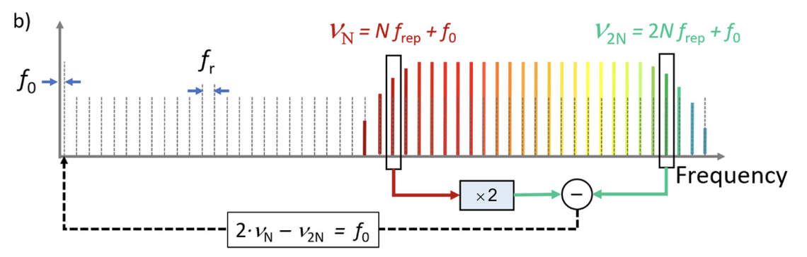
Self-referencing technique
Self referencing technique is to make the different pulse to be phase locked. So, you beat note the f-2f to make the comb itself stable.
$$v_{N}=N{×f}_{rep}+f_{0}$$
Difference frequency comb is a kind of comb to lock the $f_{0}$ to ZERO.
T. Fortier, E. Baumann, Communications Physics(2019)

Slide 11
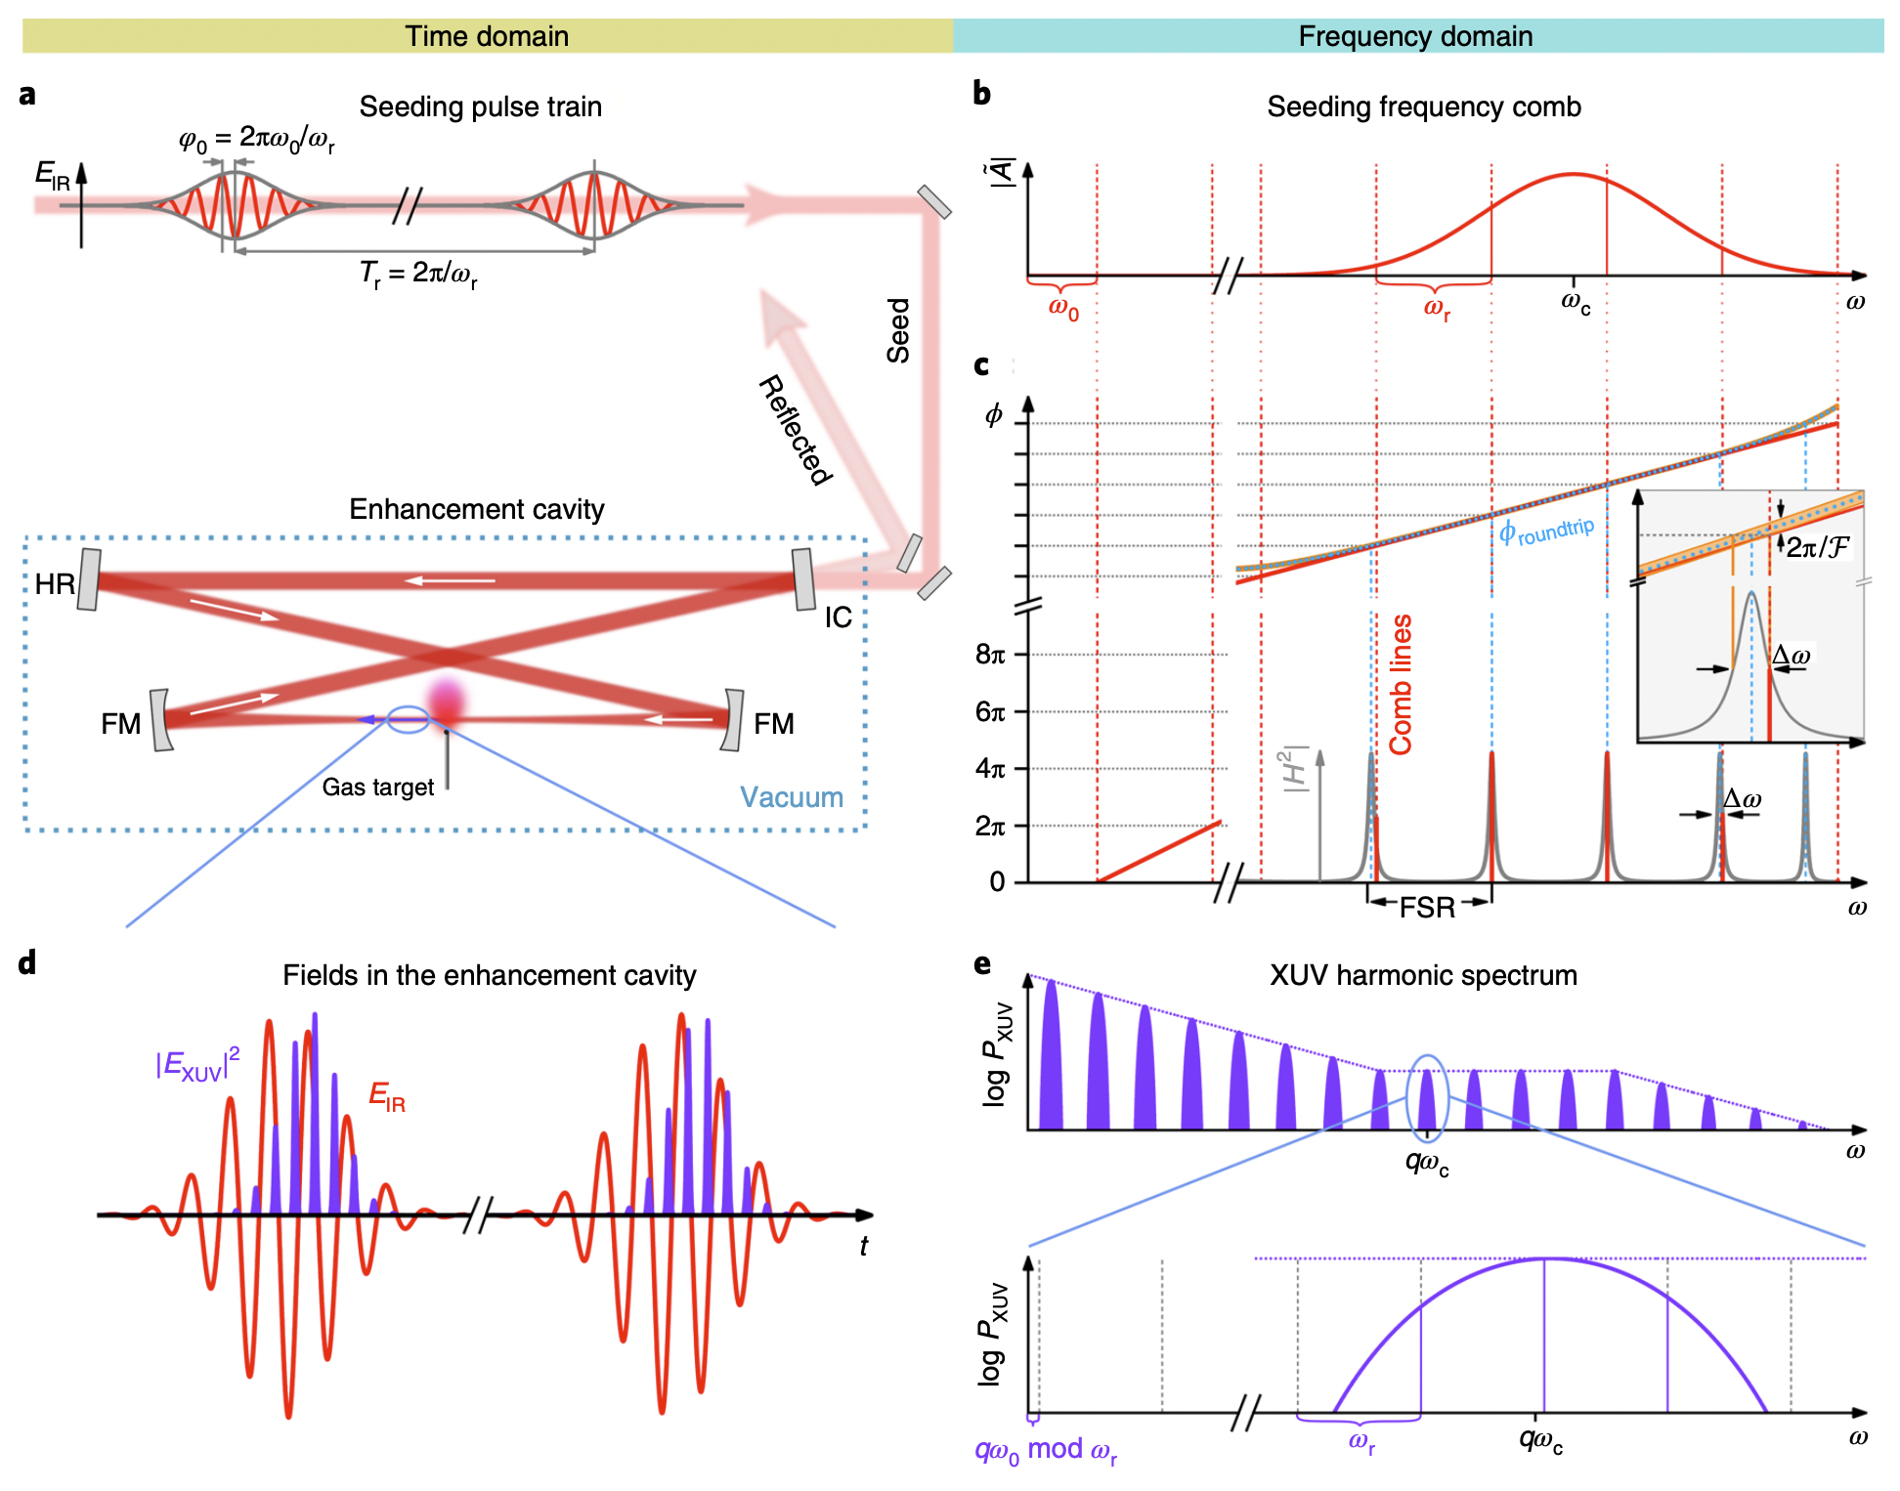
Frequency comb for spectroscopy
N. Picqué, T. W. Hänsch, Nature Photonics(2019)
I. Pupeza, C. Zhang, M. Högner, J. Ye, Nature Photonics(2021)
Notes:
Their fiber amplifier is 1020-1060, f_rep = 75MHz, 10^5 tunes
To enhancement the light to 7kW, increasing the power to get HHG, we use a cavity with FSR=75MHz, so the light can be accumulated in the cavity.

Slide 12
How to mode-lock?
Q switch is only enough to provide ns. This is to tune the cavity Q.
Mode-locked laser is not Q-switch, it synchronize different signals rather than tuning the Q
Using EOM: EOM can synchronize the phase of ν, ν − f and ν + f. If the modulator is driven at the same frequency as the cavity mode spacing Δν. Since the sidebands are driven in-phase, the central mode and the adjacent modes will be phase-locked together.
Another way to think is, the modulation frequency f is corresponding to the period of phonon trip in cavity. Every time it can be increase to v+f, v+2f…
https://en.wikipedia.org/wiki/Mode_locking

Slide 13
Using Comb to lock laser
To use the comb, you need to beat note it with the light you want to use.
Also you can pick up a tune by using grating. Or dicro. Or birefringent effect.

Slide 14
Part 2. Laser locking

Slide 15
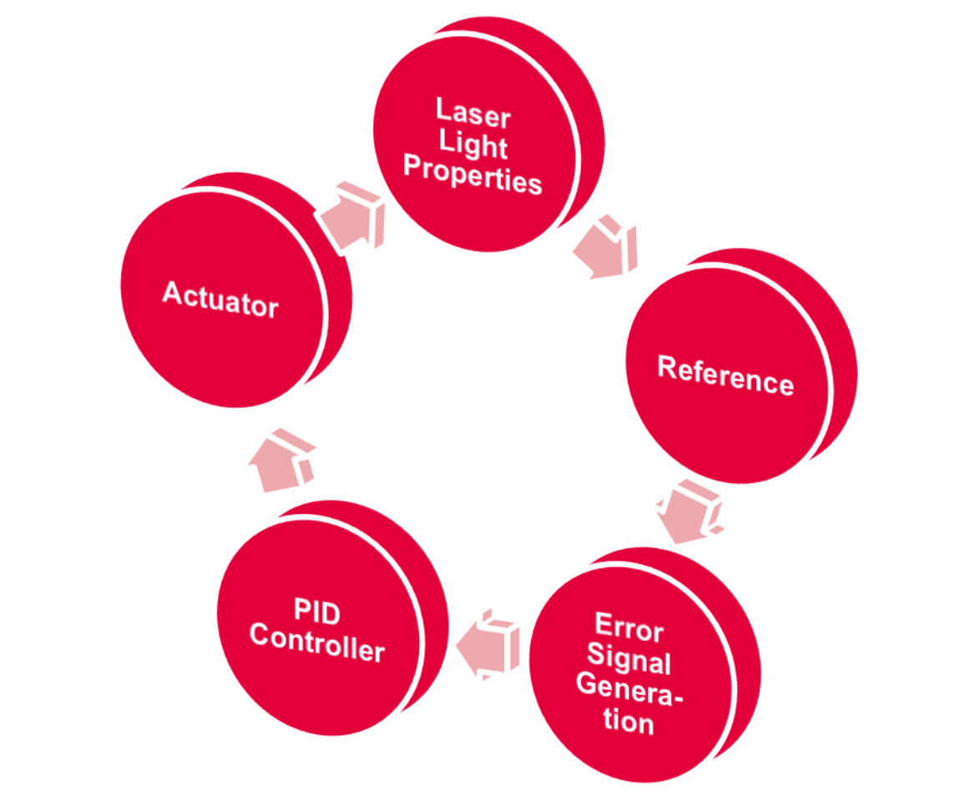
What is laser locking?
https://www.toptica.com/fileadmin/Editors_English/04_applications/10_application_notes/01_Application_Note_-_Phase_and_Frequency_Locking_of_Diode_Lasers/Phase_and_Frequency_Locking_of_Diode_Lasers.pdf
E.g. DFB, dye laser, Ti: Sapphire…
Current, temperature, piezo
E.g. Wavemeter, comb, cavity
Two concerns
Accuracy
Stability
Lock into zero-point
Measure difference,
PDH locking

Slide 16
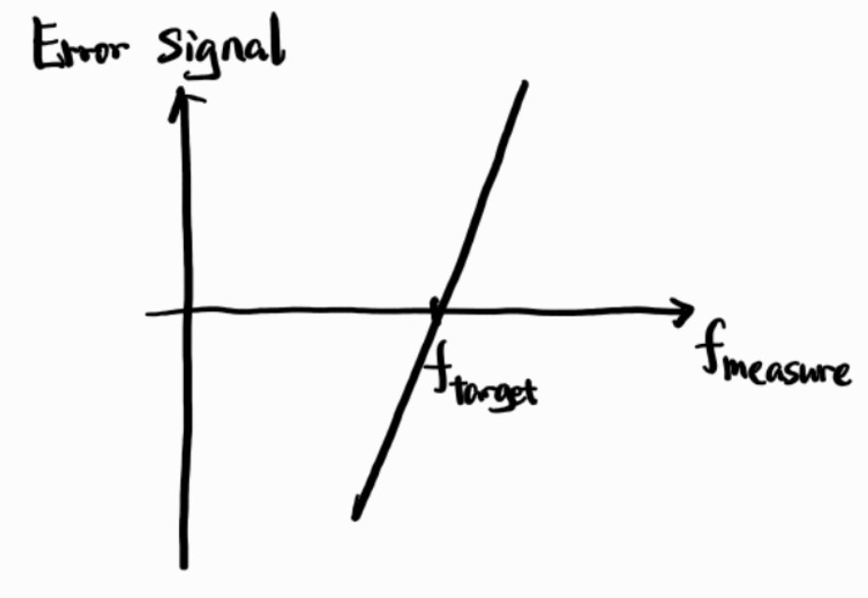
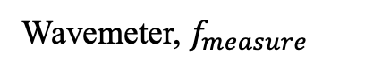
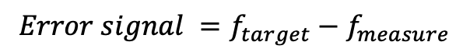
Wavemeter
https://www.toptica.com/fileadmin/Editors_English/04_applications/10_application_notes/01_Application_Note_-_Phase_and_Frequency_Locking_of_Diode_Lasers/Phase_and_Frequency_Locking_of_Diode_Lasers.pdf
ECDL laser
Tune the wavelength by tuning current or temperature
Wavemeter, $f_{measure}$
Two concerns:
Accuracy: 2MHz
Stability: hmm yeah
$$Error signal =f_{target}−f_{measure}$$

Slide 17
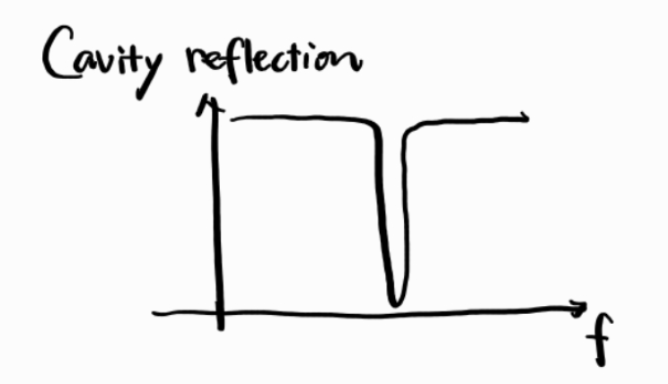
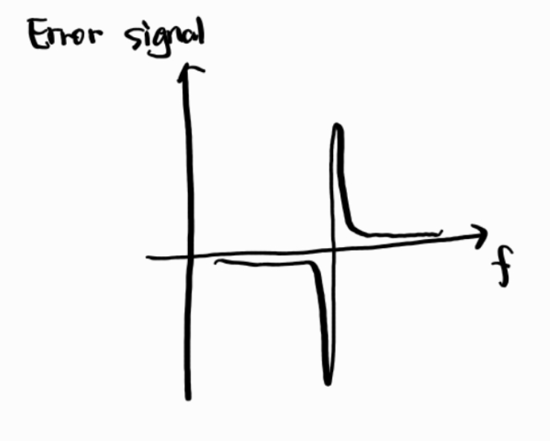
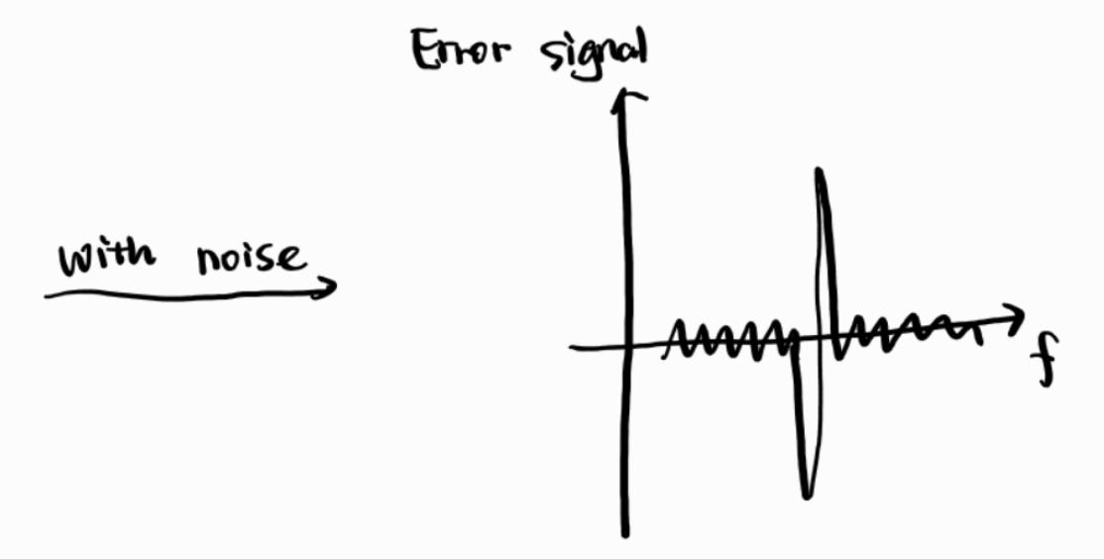
What kind of error signal do we like? (for cavity)
Two concerns:
Accuracy, need a steer slop
Stability, the other zero point
Accurate but not stable
Notes:
加一个线宽，然后信号浮动。PID很重要，能决定最后到达的线宽的极限，是一个因素。

Slide 18
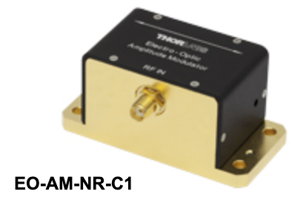
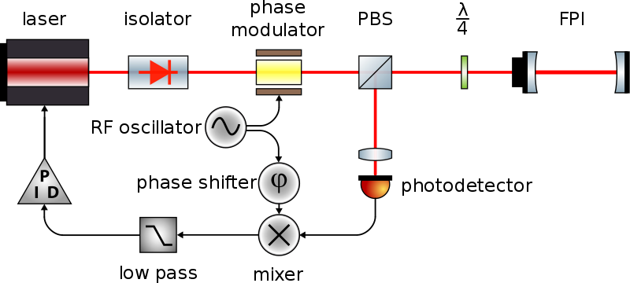
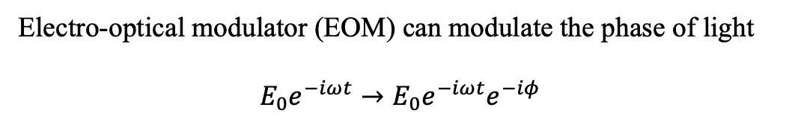
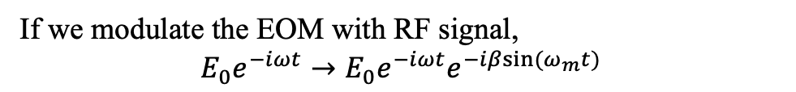
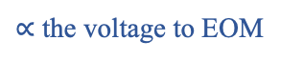
Pound-Drever-Hall (PDH) locking
Electro-optical modulator (EOM) can modulate the phase of light
$$E_{0}e^{−iωt}→E_{0}e^{−iωt}e^{−iφ}$$
$∝$ the voltage to EOM
If we modulate the EOM with RF signal,
$$E_{0}e^{−iωt}→E_{0}e^{−iωt}e^{−iβsin(ω_{m}t)}$$

Slide 19
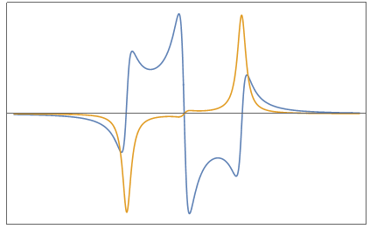
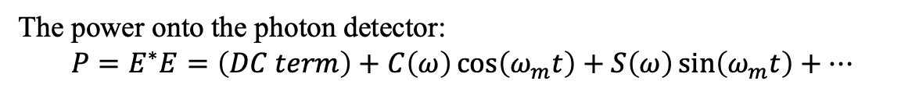

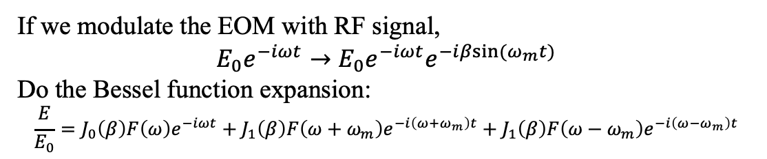
Pound-Drever-Hall (PDH) locking
If we modulate the EOM with RF signal,
$$E_{0}e^{−iωt}→E_{0}e^{−iωt}e^{−iβsin(ω_{m}t)}$$
Do the Bessel function expansion:
$$\frac{E}{E_{0}}=J_{0}\left(β\right)F\left(ω\right)e^{−iωt}+J_{1}\left(β\right)F\left(ω+ω_{m}\right)e^{−i\left(ω+ω_{m}\right)t}+J_{1}\left(β\right)F\left(ω−ω_{m}\right)e^{−i\left(ω−ω_{m}\right)t}$$
The power onto the photon detector:
$$P=E^{∗}E=\left(DC term\right)+C\left(ω\right)\cos\left(ω_{m}t\right)+S\left(ω\right)\sin\left(ω_{m}t\right)+…$$
$$ω$$
sin: yellow, cos: blue
Notes:
https://zhuanlan.zhihu.com/p/451849194
A good reference.

Slide 20
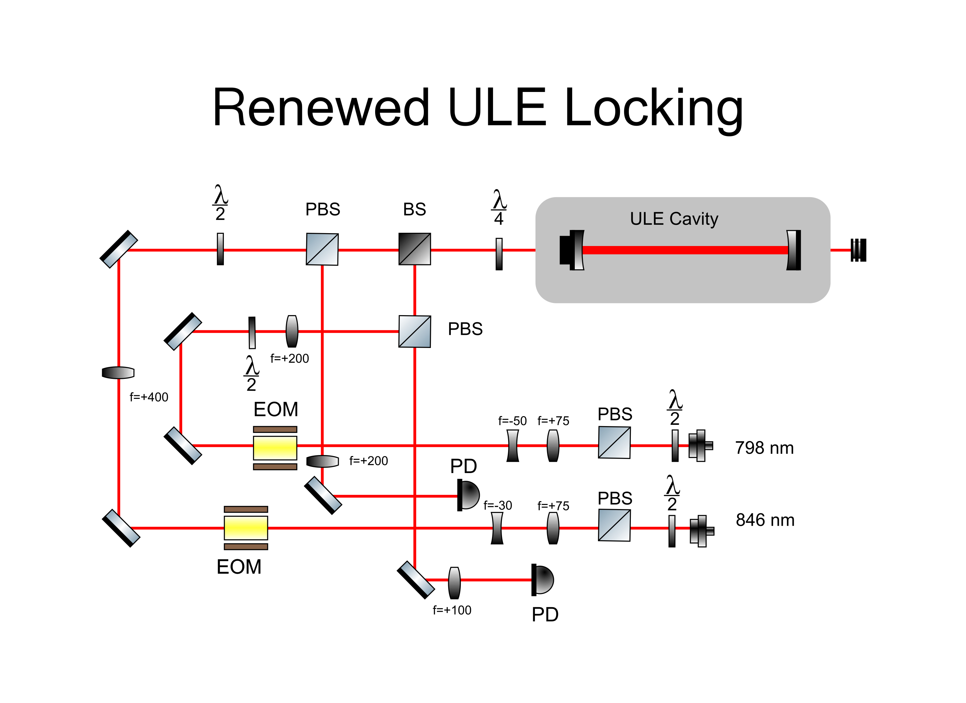
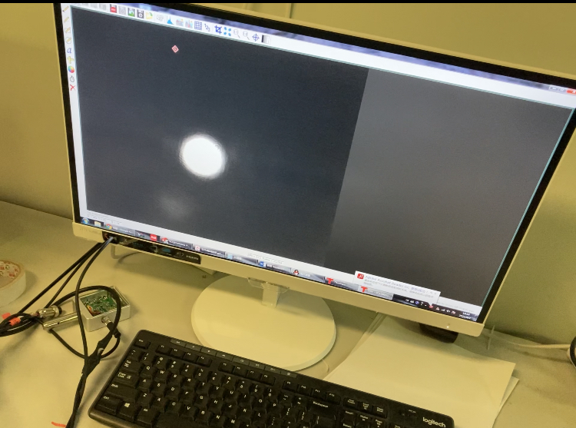
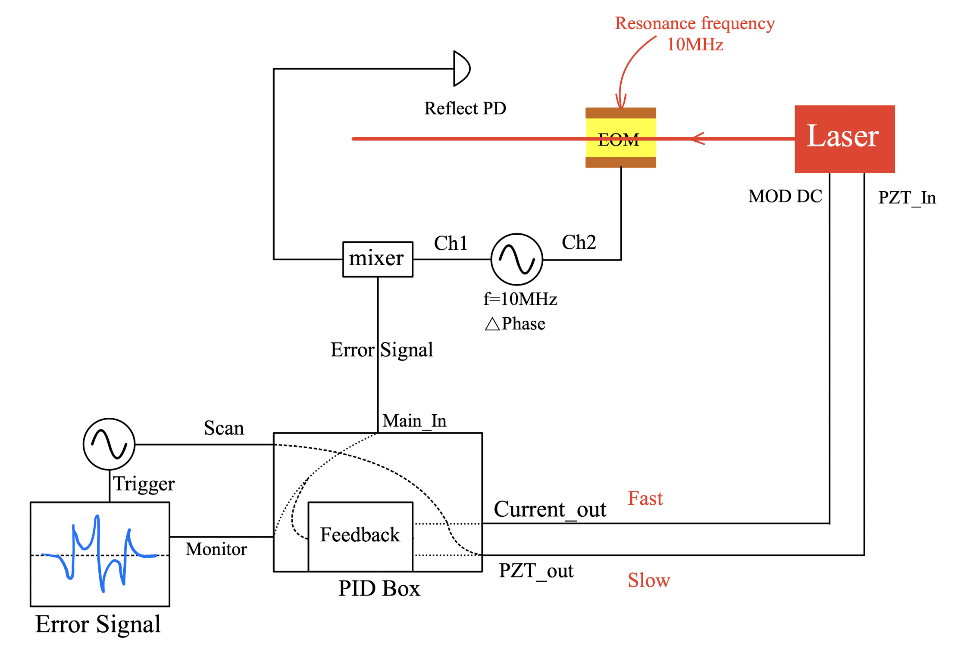
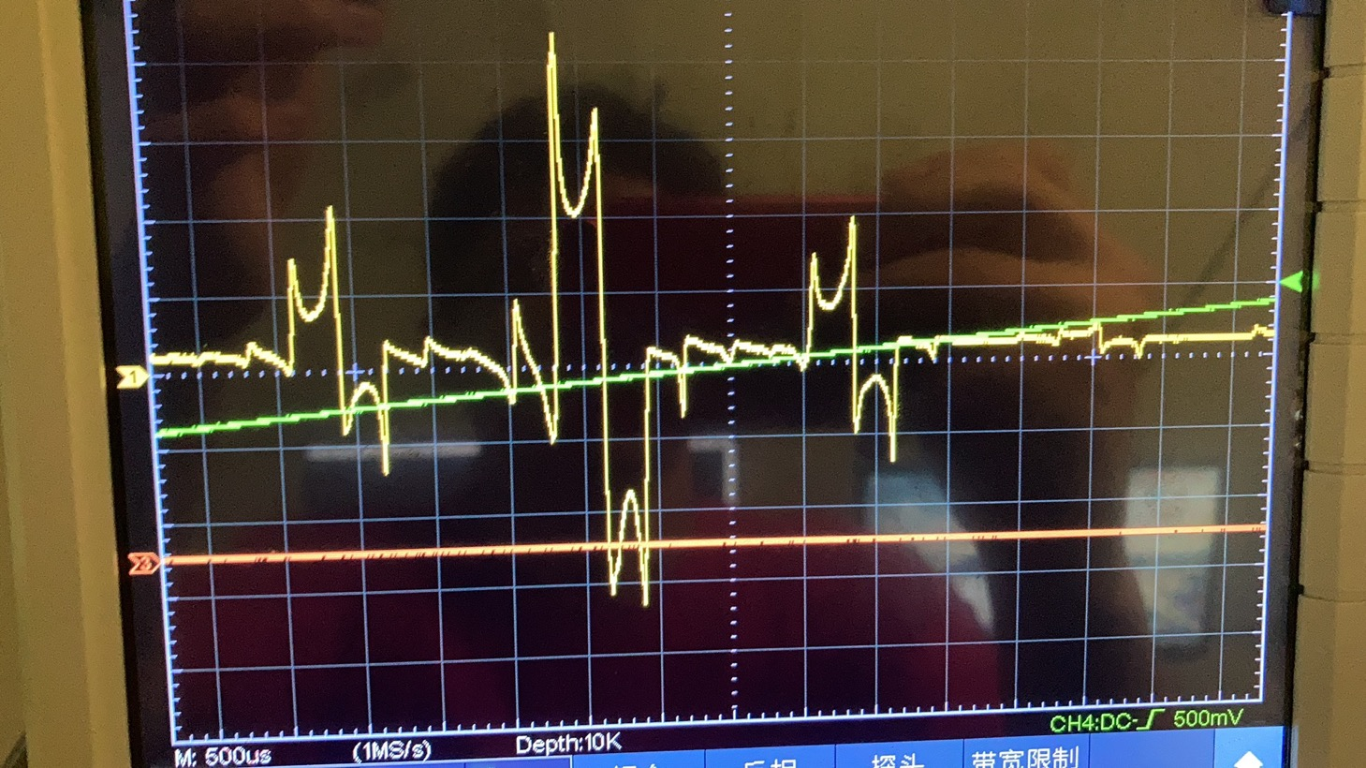
PDH locking of 798 & 846

Slide 21
Thanks for attention!

